Slide 1

Tutorial

Slide 2










Various Deep Learning Toolkits

Slide 3
Deep Learning Toolkits Trend

Slide 4
Deep Learning Toolkits Trend

Slide 5
Chapter 1: Tensor
TensorFlow 2 Tutorial
Chapter 1
Tensor
Tensor

Slide 6

Chapter 2: Datasets
TensorFlow 2 Tutorial
Chapter 2
Datasets

Slide 7
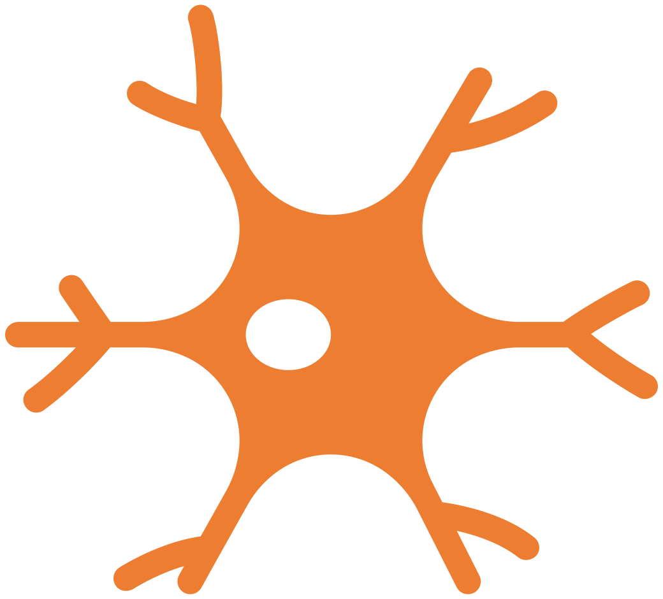
Chapter 2: Neural Networks
TensorFlow 2 Tutorial
Chapter 3
Neural Networks

